Slide 1
LEAVE MANAGEMENT SYSTEM
L.MRUDULA
Axis10JFSB1019

Slide 2
Abstract:
Leave Management System is a web application for managing employee leaves. This application provides all the things that a project/team to apply leave. Through this application one can easily manage leaves. Application maintenance is easy.
Basically this application comprises of two Users.
1.Manager
2.Employee

Slide 3
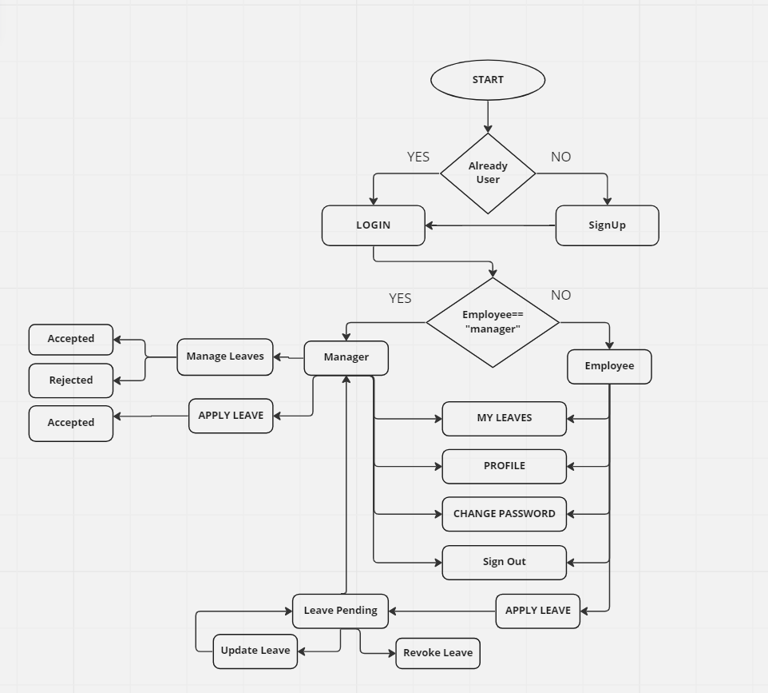
Flow Chart:

Slide 4
Proposed System:
Basically There are two kind of Users. Employee and Manager
Employee can Apply Leaves, Manager can apply leaves, accepts and rejects the employee leaves.
Users can check their profile , leave count, leaves history.
Users can update and revoke leaves
Users can change their password
Users can navigate to modules through side bar and also using Home page.

Slide 5
Modules
Employee:
Manager:
Login
Sign Up
Home
Apply Leave
My Leaves
Profile
Change Password
Sign Out
Login
Sign Up
Home
Apply Leave
Manage Leaves
My Leaves
Profile
Change Password
Sign Out

Slide 6
Module Explanation:
Login : User can login with the employee id and password
Signup : If user is not registered he will give the details
Home : We can access any module from here. We will have the description of
every module here.
Profile : User can see their profile along with leave count.
My Leaves: User can check their leave history.

Slide 7
Module Explanation:
Apply Leave : User can apply leave.
1.It will be in pending state until manager accepts.
2.If manager accepts leave status will change to accepted and the leave count increases.
3.If manager rejects leave status will be rejected.
Manage Leaves : Manager can accepts and rejects the leaves which are in pending.
1. Manger also have all the options which user can access.
Change Password : User can change password by giving old password , new password and confirm password.
Sign Out : User can exit from the application

Slide 8
Backend:
Micro services(Employee and Leave Management)
Eureka Server
Api Gateway
Feign Client
Swagger UI
MongoDB(Storing data)
Frontend:
React Js
MDB(Material design for Bootstrap)
Html , Css

Slide 9






Tools Used

Slide 10
Execution

Slide 11
Snapshots of Execution:

Slide 12
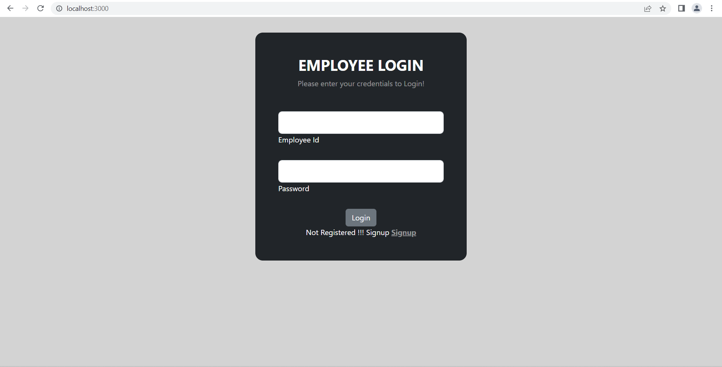

Slide 13
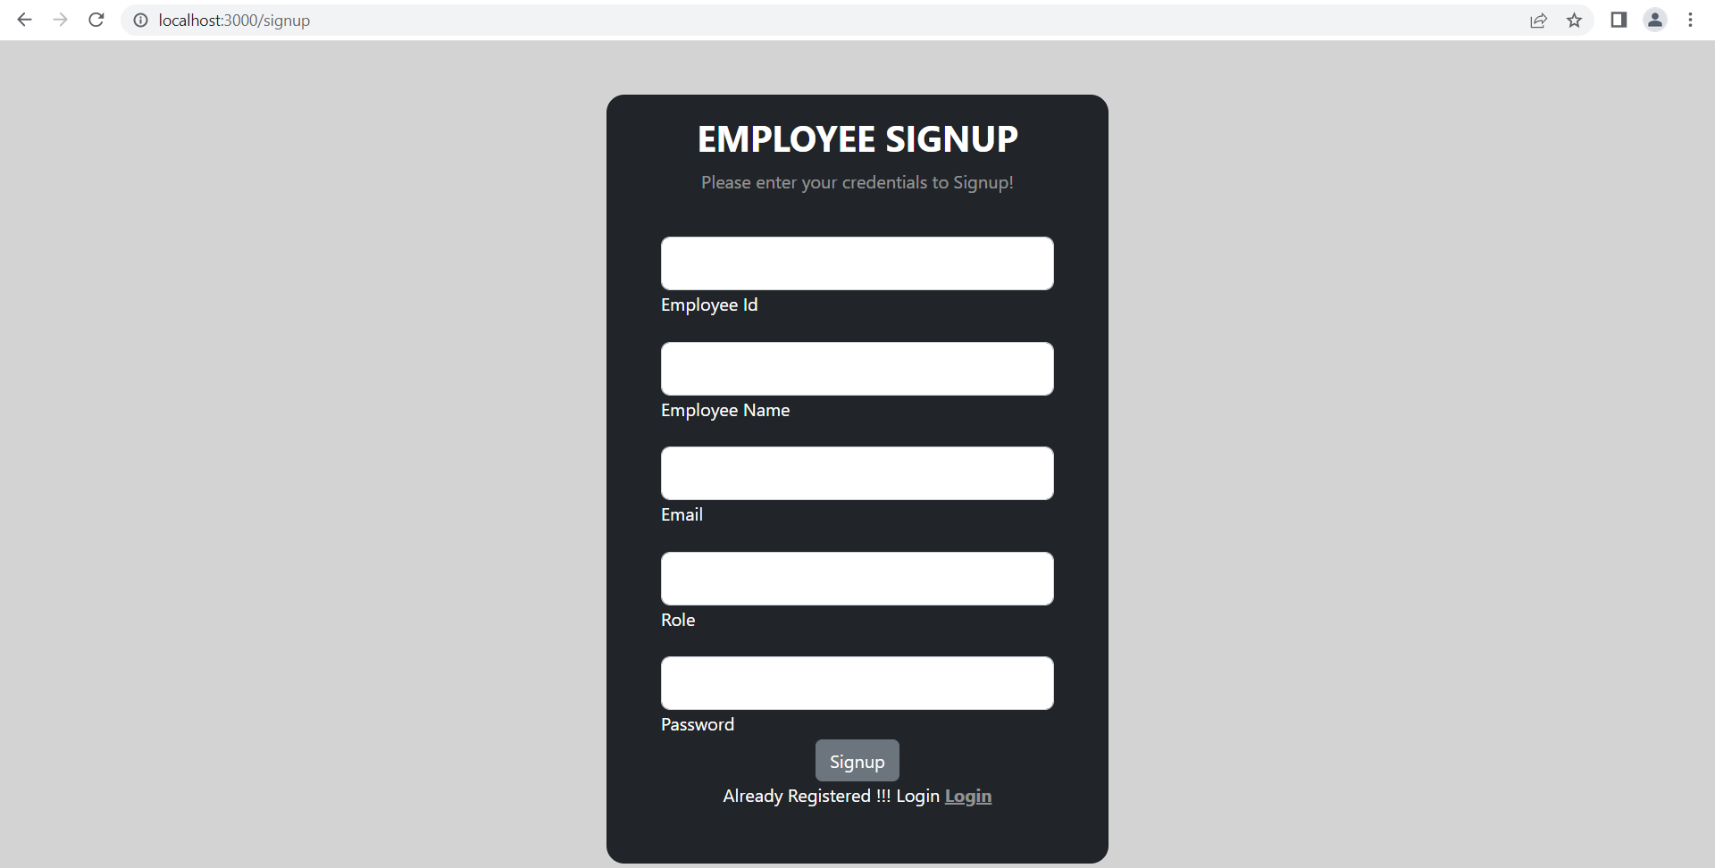

Slide 14
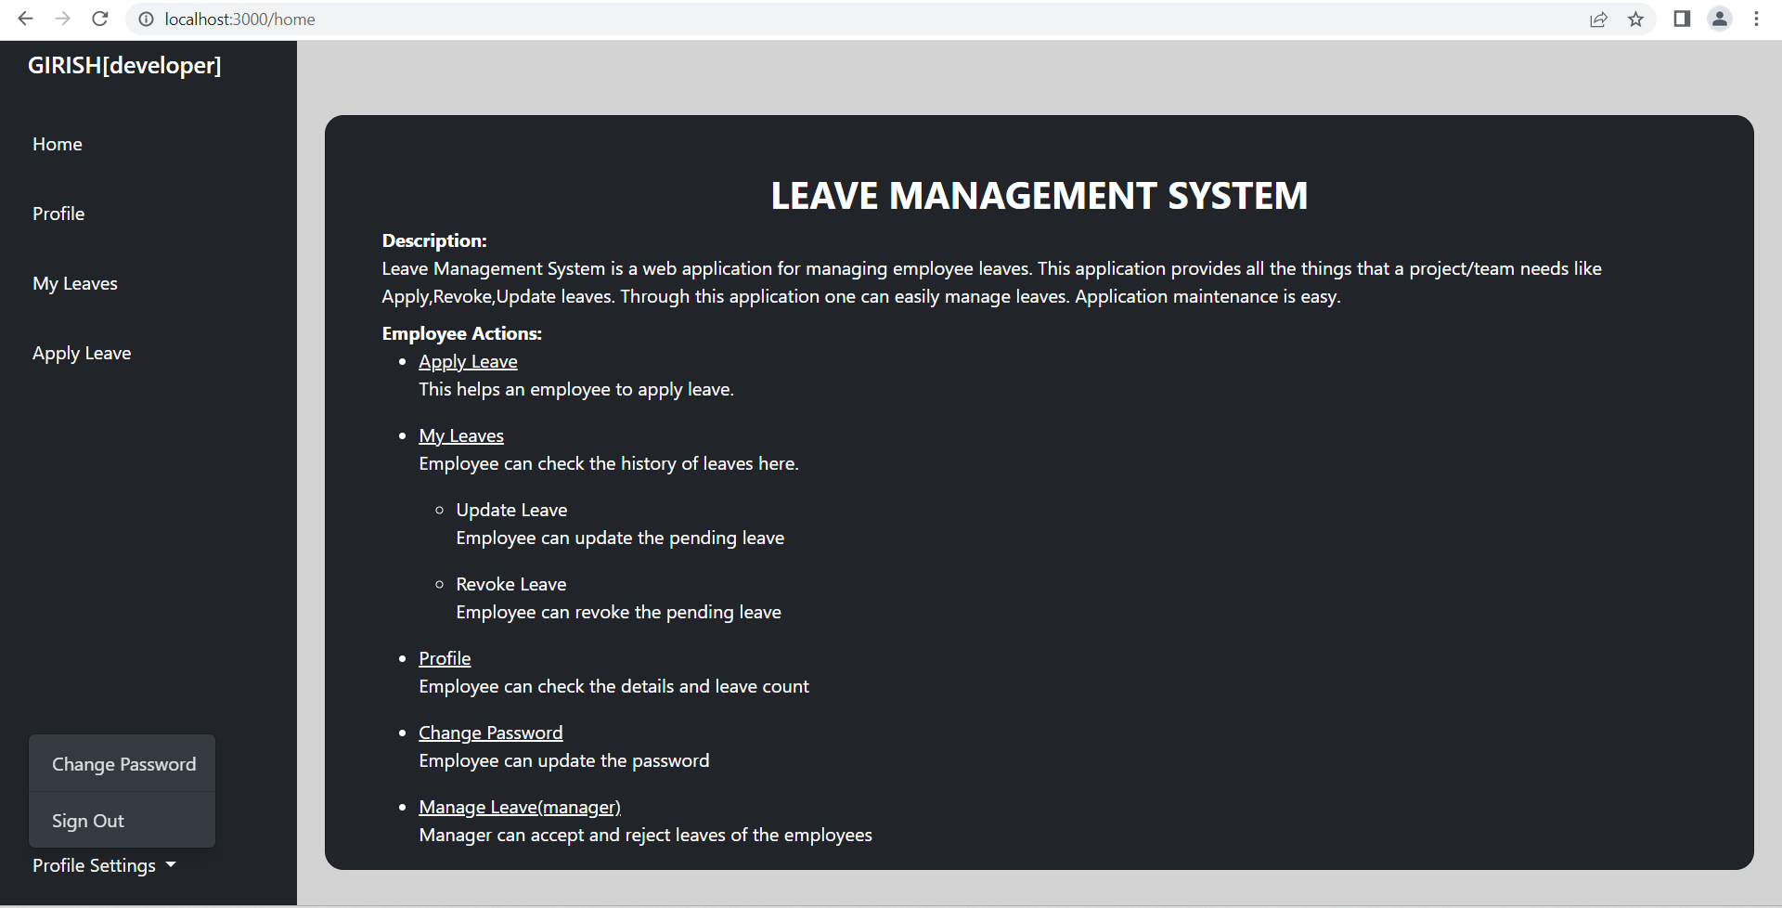

Slide 15


Slide 16
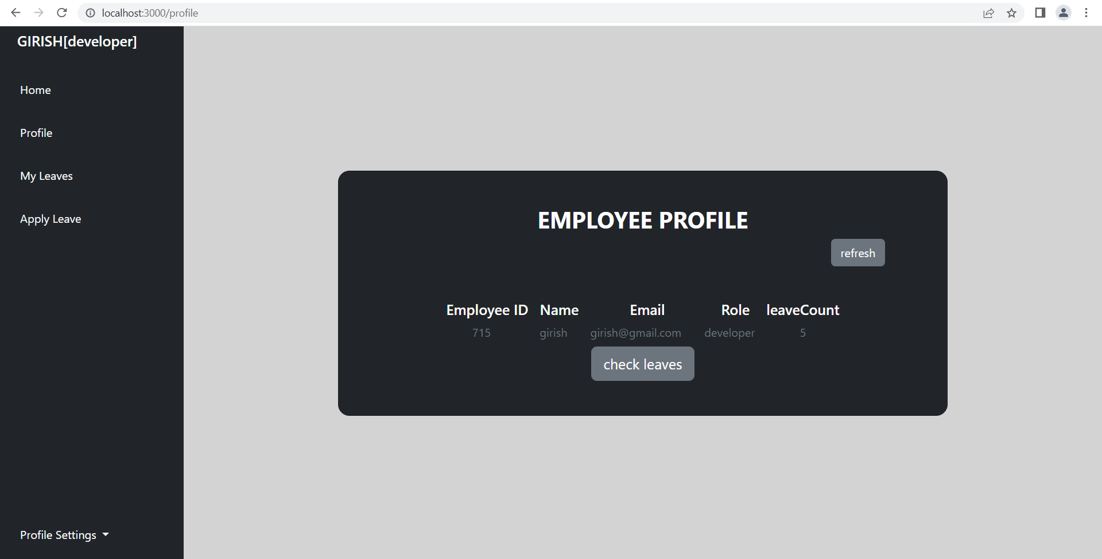

Slide 17
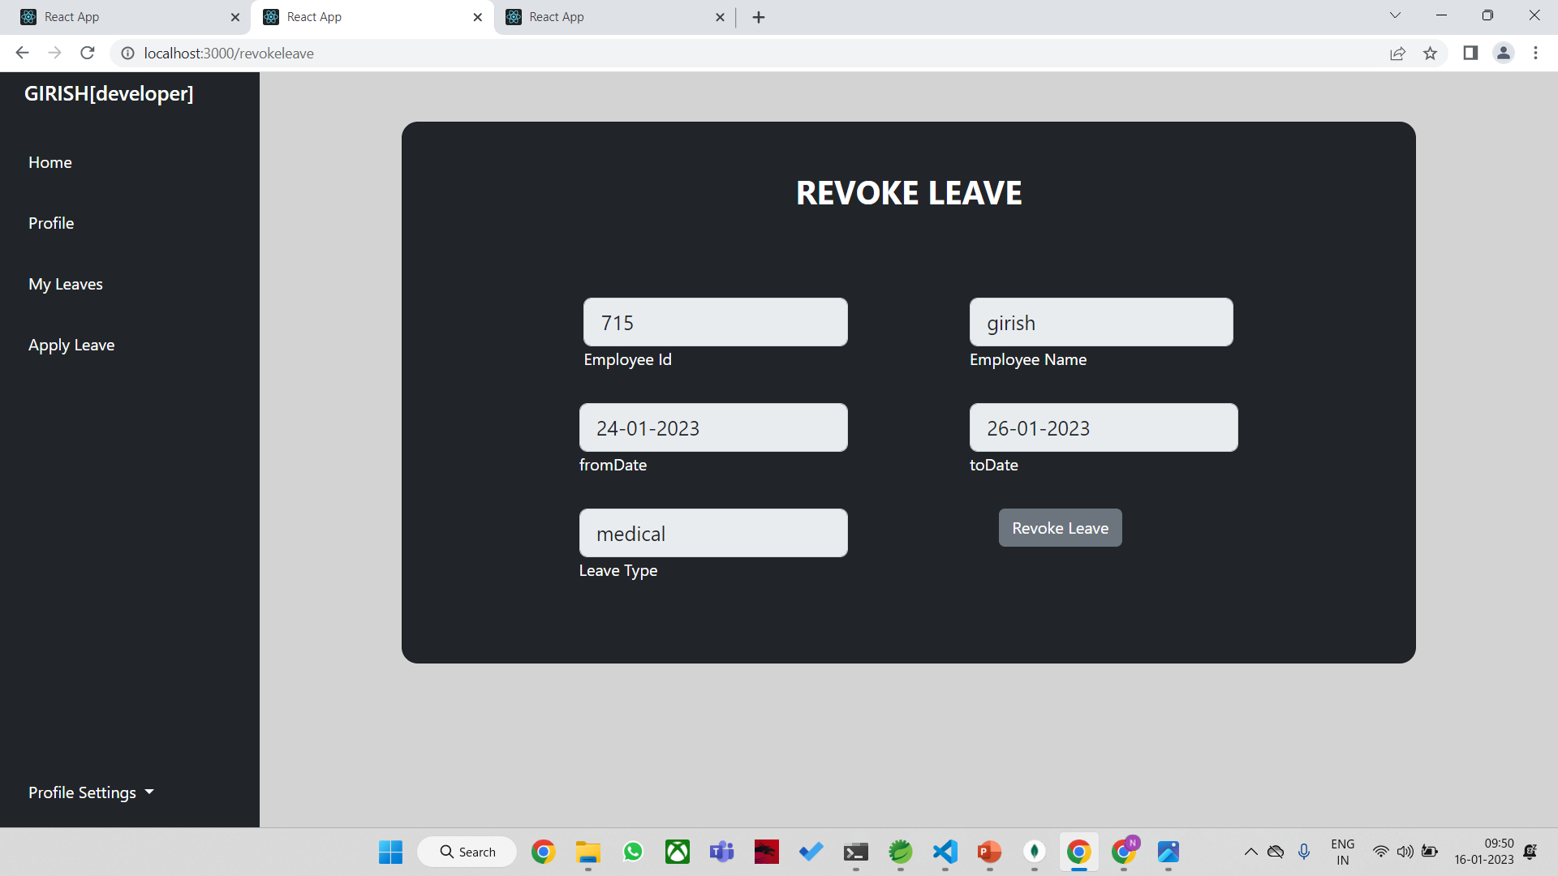

Slide 18
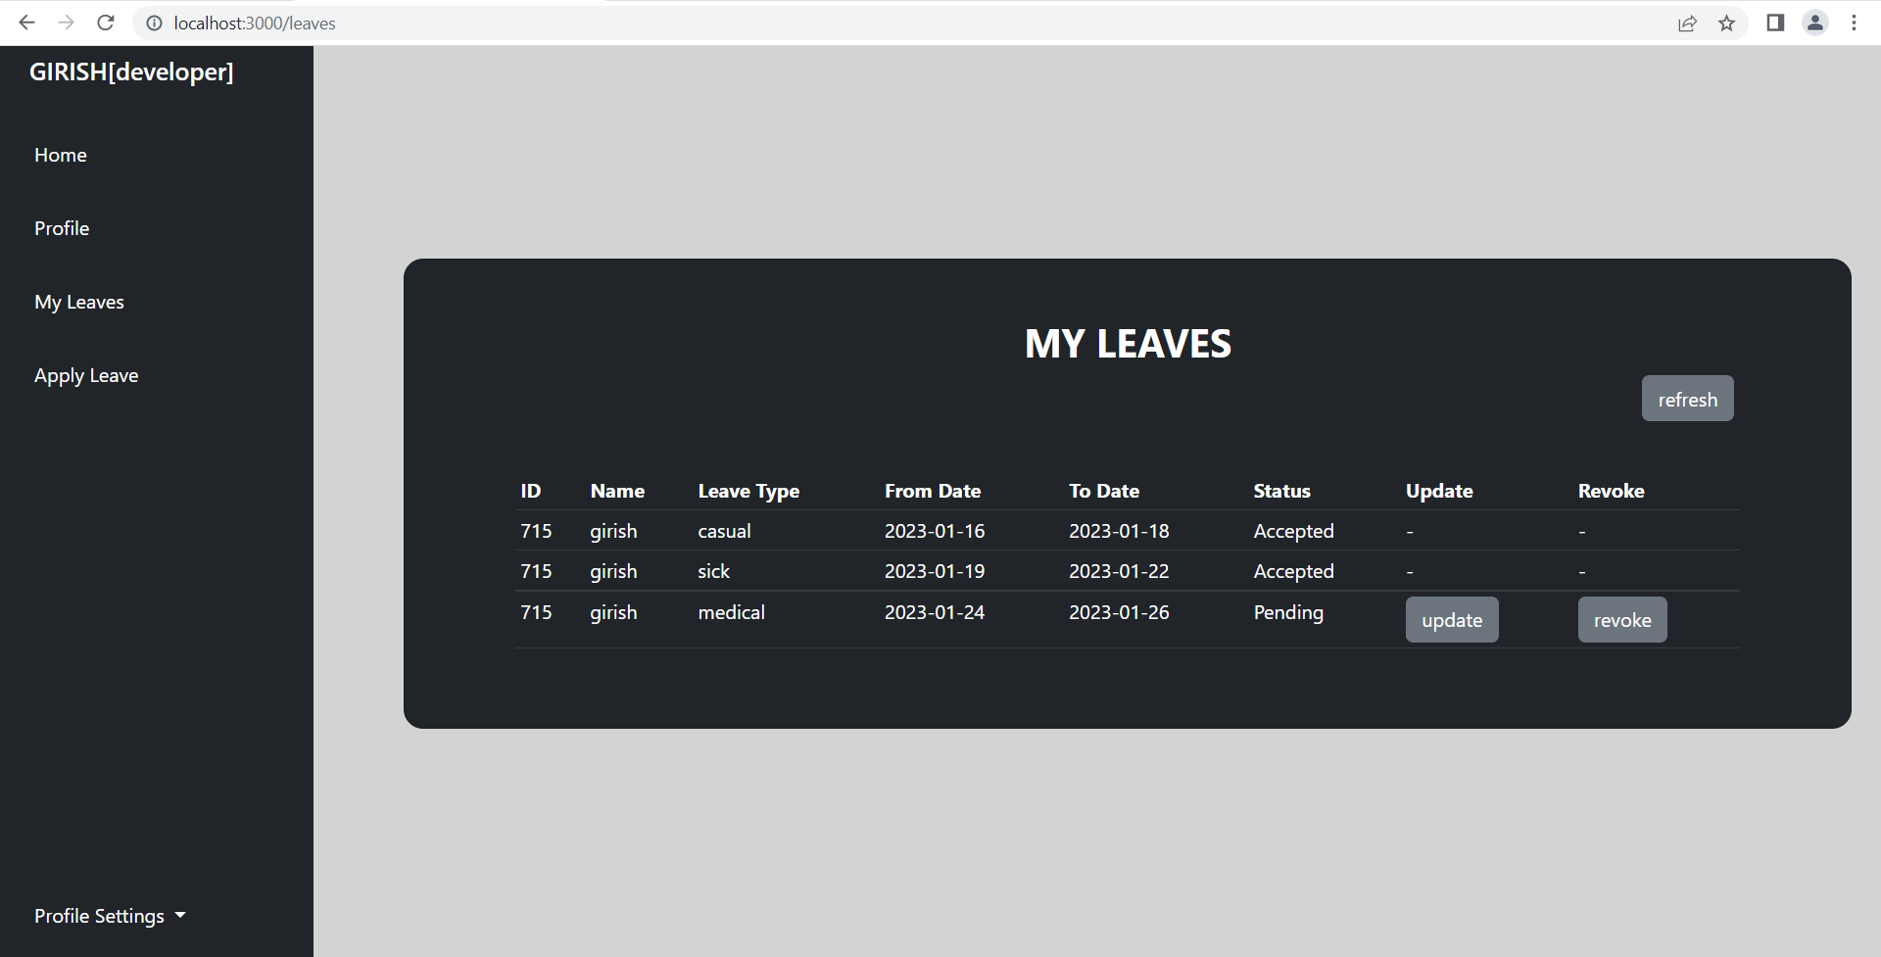

Slide 19
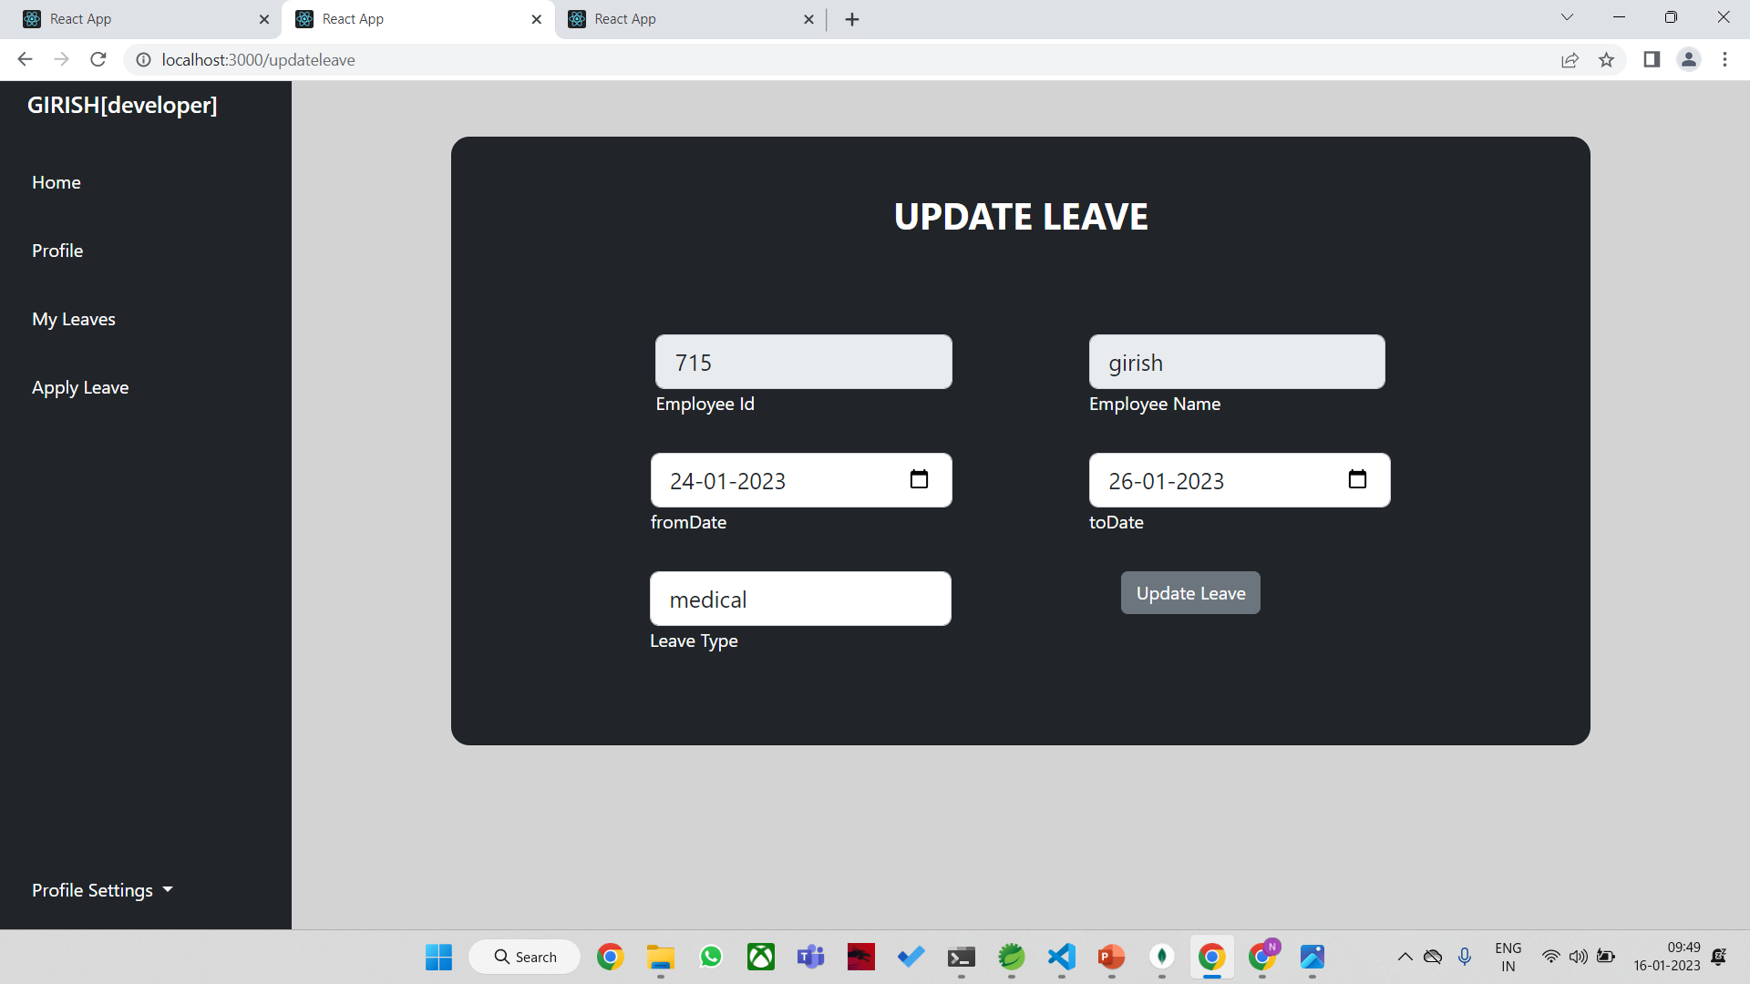

Slide 21
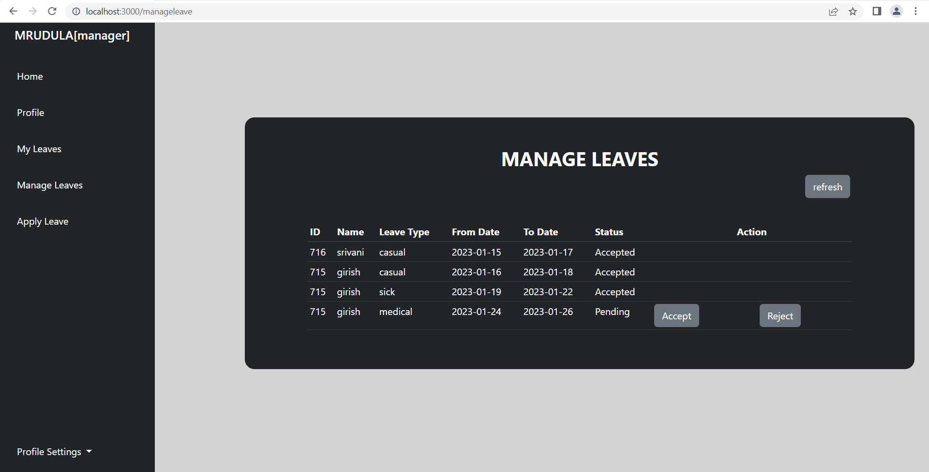

Slide 22
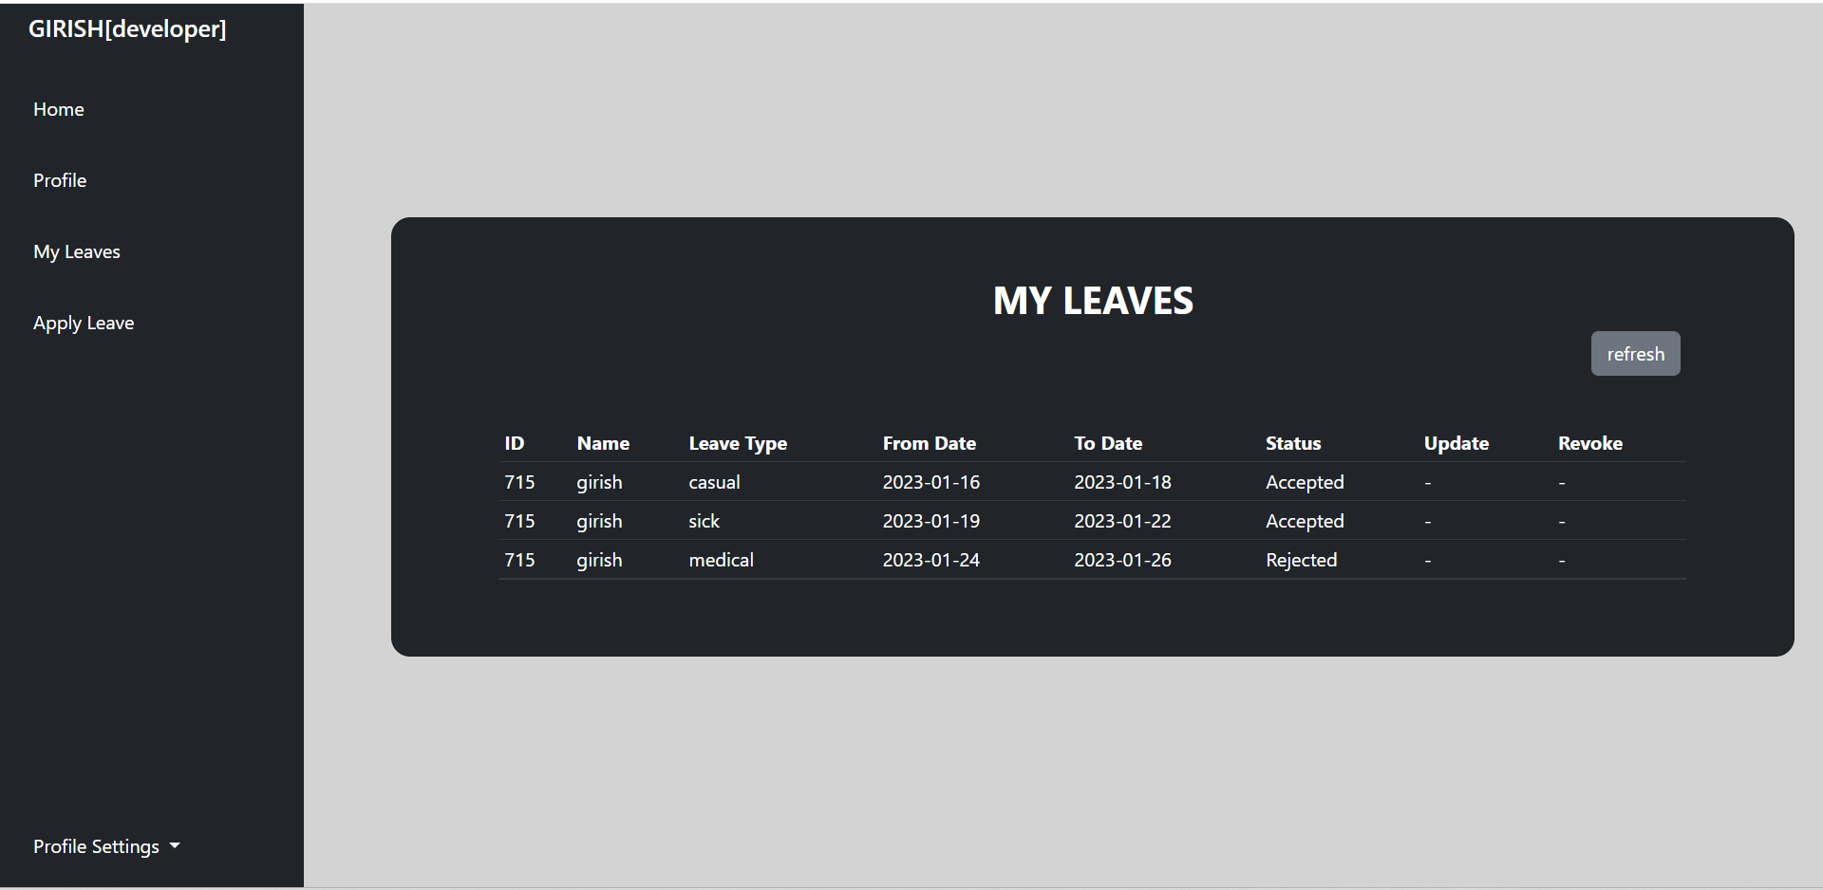

Slide 23
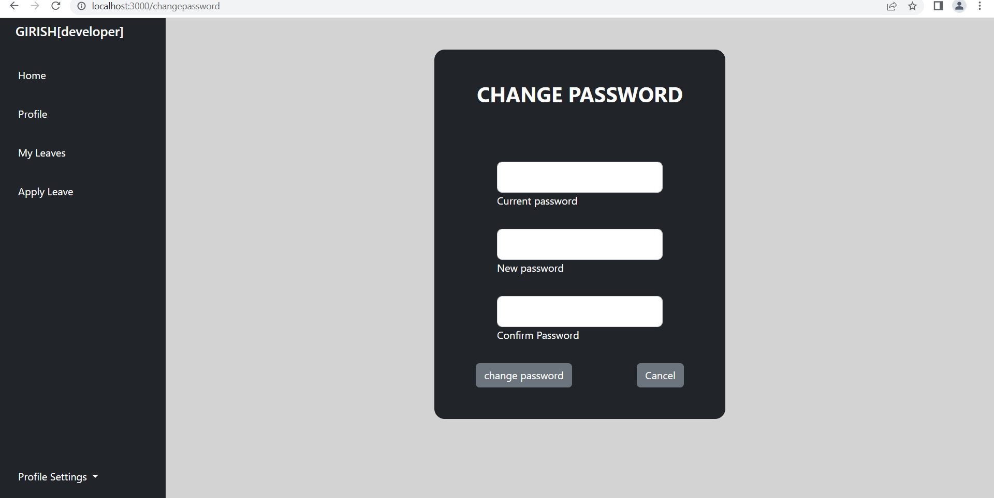

Slide 24
THANK YOU

